Slide 1
Course Introduction
Module-0 Course Introduction

Slide 2
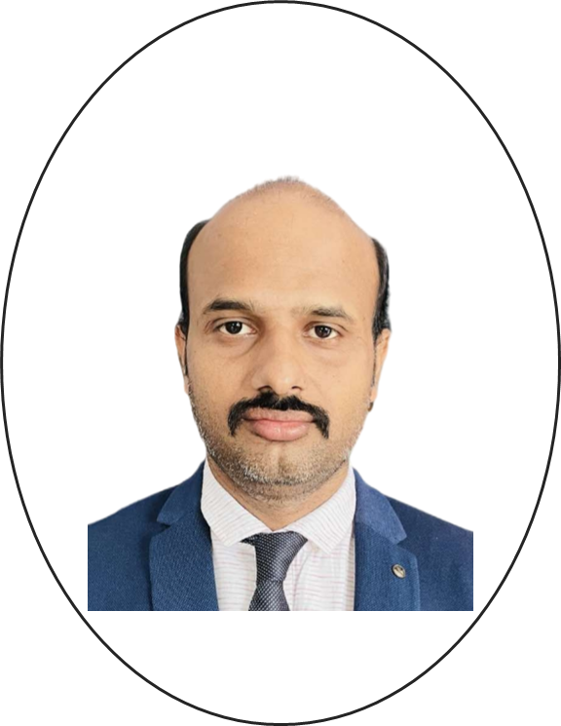
Instructor Introduction
Name: Manohar Reddy Patlolla
Experience:
14+ years of experience as a corporate Trainer in delivering trainings on Microsoft, VMWare, AWS and Google
Certifications:
Microsoft (Az-104, AZ-800, AZ-801, AZ-305,,AZ-500)
VMWare( VCP-DCV, VCP- NV, VMC on AWS, VSAN)
Google(GCP-Google Cloud Professional)
AWS(SAA, SAP, Database Specialty, Data Analytics Specialty)

Slide 3
Course Introduction
This Course covers:
Planning High-Performance Infrastructure
Foundations of Service Delivery
Improving Code Quality
Discovering Cloud Solutions
Foundations of Machine Learning

Slide 4

Logistics
Breaks and lunch
Security
Cellphones

Slide 5

About you
Tell us the following:
First name
Organization and role
What do you expect of this course?

